Slide 1


Real-World Client Health Consultant
-Nutrition Project-
Dr. Xiaohui Chang (Advisor)
Chesta Gupta
Claire G Elsbree
Eunjeong Heo
Mingyang Zhang
Nayoung Kwon
Robert M Hill

Slide 2
Content
01 Project Introduction
02 Roadmap
03 Data Visualization
04 Conclusion

Slide 3



01 Project Introduction
External Goal
Internal Goal
Customer Satisfaction
Data-Driven
Health Care Advice
Leverage Data Analysis Experience for
Career
Notes:
The food and nutrition project helps our project client Jim (alias) learn to make healthy food choices, improve energy and alertness, reduce disease and illness risks, and gain knowledge of nutrients through the data-driven analysis.

Slide 4
02 Project Roadmap
[ Data Exploration Process ]
D
A
T
A
Do some exploratory analysis
Deal with outliers and missing data
Get the data
Look at summaries

Slide 5
02 Data Source
Overview of Data and Variables
Exercise
Bloodwork
Nutrition
Notes:
Jim has kept extensive records of data relating to his health over many years. We received 6,400 hundred rows of nutritional data going back to 2014 that told us how many meals he ate in a day plus the nutritional content for each meal, including calories, fat content, carbohydrates, protein, cholesterol, sodium, potassium, Vitamins A and C, Calcium, and Iron. We also received some weight data. Jim also provided us with the results of eight blood tests done between 2009 and 2019, though we only used the five tests from 2014 to 2019 in order to compare bloodwork with the other variables gathered like the nutritional data. Jim also has a very active lifestyle and has tracked the type and length of exercise he has done since 2014. He primarily does High intensity interval training, Brazilian Jiu Jitsu, and weight training combined with cardio. Finally, we also have about a years worth of sleep data going back to early 2020. There are periods of time that we don’t have data for which we had to keep in mind when doing our analysis. For most of 2016, Jim did not track his meals. It can be challenge when analyzing this data and not knowing whether, for example, Jim didn’t exercise for several months or if he simply wasn’t recording exercise for that period of time. As we continue to undergo this analysis, communication with Jim will be important to make sure we have the information that we need.

Slide 6
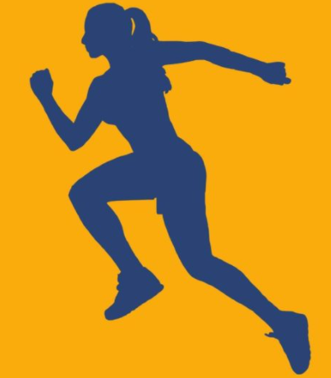
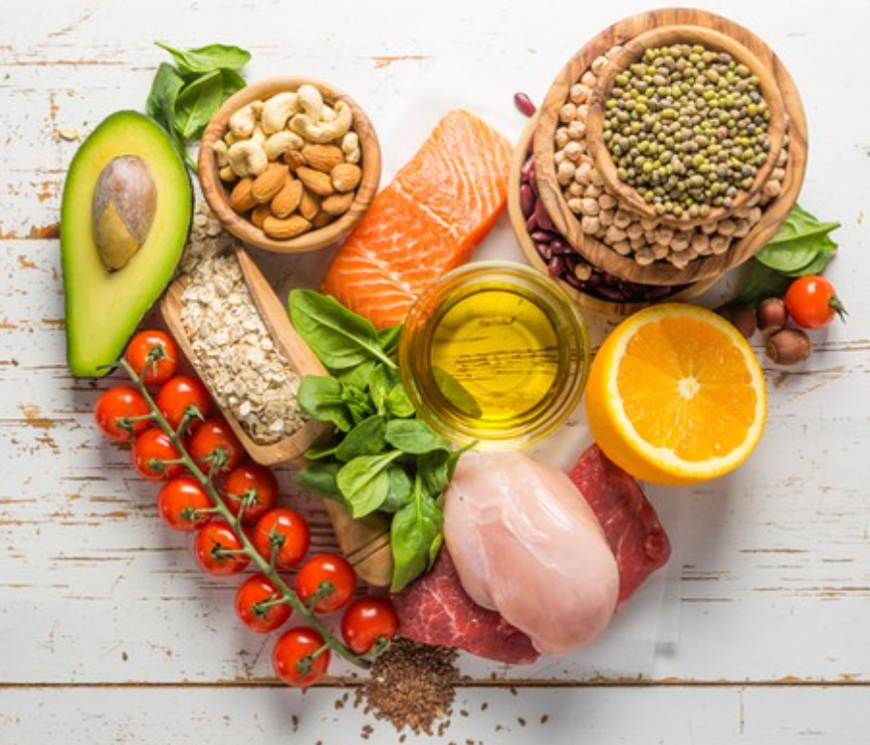
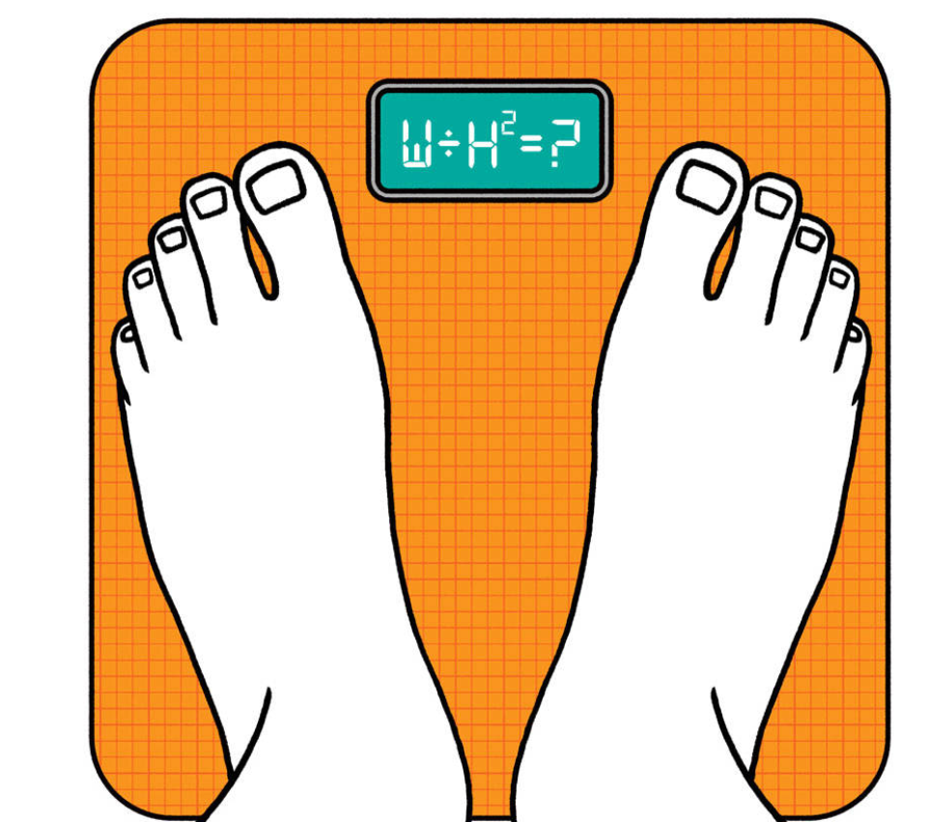
Nutrition (Diet-1)
Paleo Diet
Percentages
Protein:
45%
Carbohydrate: 35%
Fat: 20%
A paleo diet typically includes lean meats, fish, fruits, vegetables, nuts and seeds — foods that in the past could be obtained by hunting and gathering. A paleo diet limits foods that became common when farming emerged about 10,000 years ago. These foods include dairy products, legumes and grains.
Paleo Diet Benefits
More Energy
Better Eating Habits
Weight Loss
https://burnbootcamp.com/paleo-macro-meal-plan/
Notes:
The client followed paleo diet for few years before switching to Keto diet plan. He was also involved in sports activities like Brazilian jiu jitsu.

Slide 7


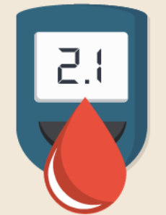
Nutrition (Diet-2)
Keto Diet
Benefits of Keto diet
Keto is a very low carb diet that shifts ones body into a metabolic state of ketosis.On a ketogenic diet carbohydrate intake is reduced. The number of grams of carb,fat and protein eaten depends heavily on the activity level.
More Fat Burn
Reduce Hunger
5% CARB
75% FAT
20% PROTEIN
Stabilize
Blood Sugar
Notes:
Keto is a very low-carb diet that shifts your body into a metabolic state of ketosis. In ketosis, your energy comes primarily from little molecules called ketone bodies, as opposed to glucose from carbs and sugar.
On a ketogenic diet, you reduce your carb intake to under about 30 grams per day. But the number of grams of carbs, fat, and protein you eat depends heavily on your activity levels and your goals.

Slide 8
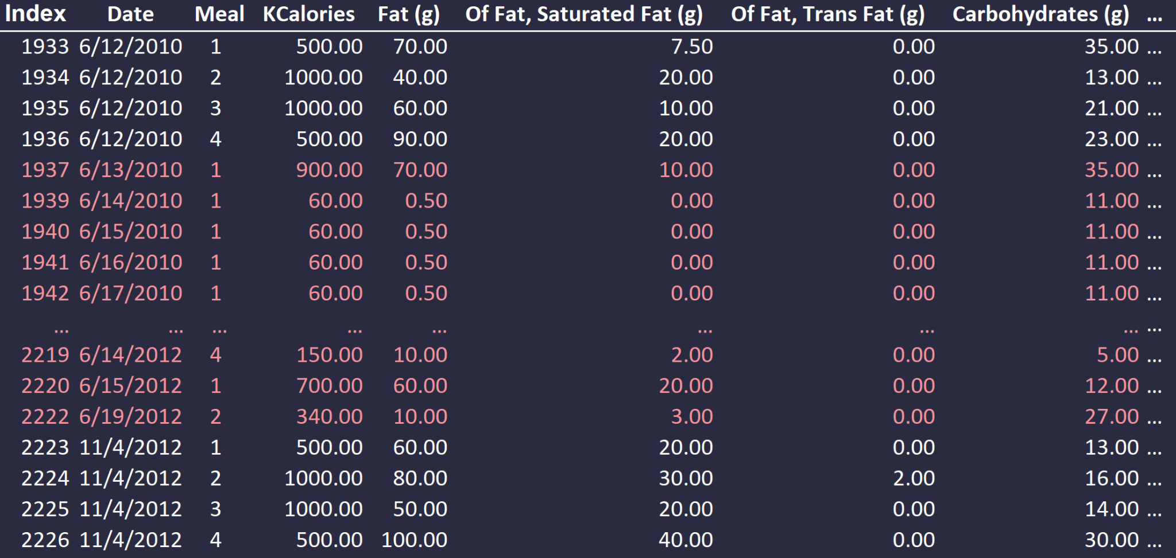
02 Data Pre-Processing
[Dealing with outliers and missing data]
Original dataset

Slide 9
02 Data Pre-Processing
[Data cleaning and aggregation]
Python – method 1
Python – method 2
# Truncate the date ranges
start_remove = pd.to_datetime('2018-01-10')
end_remove = pd.to_datetime('2018-03-03')
df1 = df.query('Date < @start_remove or Date > @end_remove')
print(df1.shape)
start_remove2 = pd.to_datetime('2015-06-13')
end_remove2 = pd.to_datetime('2017-11-04')
df1 = df.query('Date < @start_remove2 or Date > @end_remove2')
print(df1.shape)
# Aggregate the data by date
df2 =df1.groupby(['Date']).sum()
df2.head()
# Convert it to csv
df2.to_csv('byDate.csv')
import pandas as pd
data = pd.read_excel (r'C:/Users/mason/OneDrive/OSU/Clubs/BA/Nutrition Project/All Combined.xlsx')
df = pd.DataFrame(data, columns = ['Date', ' KCalories '])
calorie_sum = {}
year = 2014
while year <= 2021:
month = 1
while month <= 12:
day = 1
while day <= 31:
date = str(month) + '/' + str(day) + '/' + str(year)
total = df.loc[df['Date'] == date, ' KCalories '].sum()
if total != 0.0:
calorie_sum.update({date: total})
#print(date, total)
day += 1
month += 1
year += 1
df = pd.DataFrame(data = calorie_sum, index = [0])
df = (df.T)
df.to_excel('calorie_sum.xlsx')

Slide 10
02 Data Pre-Processing
[Little did I know...]
Pandas.DataFrame.groupby
Example
DataFrame.groupby(by=None, axis=0, level=None, as_index=True, sort=True, group_keys=True, squeeze=<object object>, observed=False, dropna=True)
Group DataFrame using a mapper or by a Series of columns.
A groupby operation involves some combination of splitting the object, applying a function, and combining the results. This can be used to group large amounts of data and compute operations on these groups.
>>> df = pd.DataFrame({'Animal': ['Falcon', 'Falcon',
'Parrot', 'Parrot'],
'Max Speed': [380., 370., 24., 26.]})
>>> df
Animal Max Speed
0 Falcon 380.0
1 Falcon 370.0
2 Parrot 24.0
3 Parrot 26.0
>>> df.groupby(['Animal']).mean()
Max Speed
Animal
Falcon 375.0
Parrot 25.0

Slide 11
02 Data Pre-Processing
[Finding relative values]
VBA
Python
Option Explicit
Sub Nutirition_Project():
Dim r As Integer
Dim fat As Double
Dim carbs As Double
Dim protein As Double
For r = 2 To Range("A2").End(xlDown).Row
' fat (%) = fat calories / total calories = (fat in grams * 9) / total calories
fat = Round(Cells(r, 8).Value / Cells(r, 4).Value, 2)
Cells(r, 5).Value = fat
' Carbs (%) = Carbs calories / total calories = (Carbs in grams * 4) / total calories
carbs = Round(Cells(r, 13).Value / Cells(r, 4).Value, 2)
Cells(r, 6).Value = carbs
' Protein (%) = Protein calories / total calories = (Protein in grams * 4) / total calories
protein = Round(Cells(r, 16).Value / Cells(r, 4).Value, 2)
Cells(r, 7).Value = protein
Next r
End Sub
import pandas as pd
data = pd.read_csv (r'C:/Users/mason/OneDrive/OSU/Clubs/BA/Nutrition Project/byDate.csv')
df = pd.DataFrame(data)
percentage_fat = (df[" Fat (g) "] * 9) / df[" KCalories "] * 100
percentage_fat = percentage_fat.astype(str)
df.loc[df['Fat (%) '] == 0, 'Fat (%) '] = percentage_fat + '%'
percentage_carb = (df[" Carbohydrates (g) "] * 4) / df[" KCalories "] * 100
percentage_carb = percentage_carb.astype(str)
df.loc[df['Carbs (%)'] == 0, 'Carbs (%)'] = percentage_carb + '%'
percentage_protein = (df[" Protein (g) "] * 4) / df[" KCalories "] * 100
percentage_protein = percentage_protein.astype(str)
df.loc[df['Protein (%)'] == 0, 'Protein (%)'] = percentage_protein + '%'
df.to_csv('percentages_calculated.csv')

Slide 12
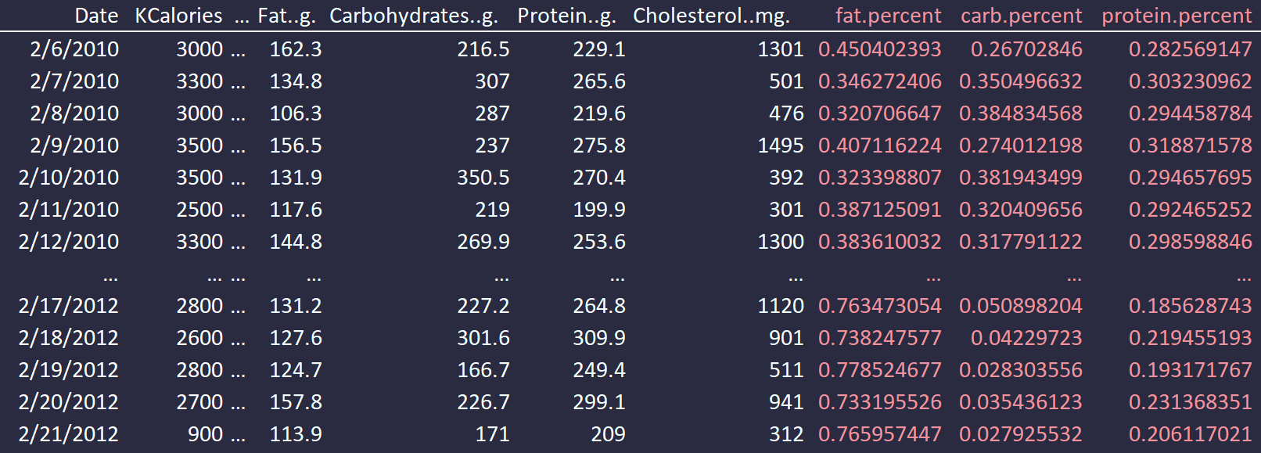
02 Data Pre-Processing
[Voilà]
Cleaned dataset

Slide 13
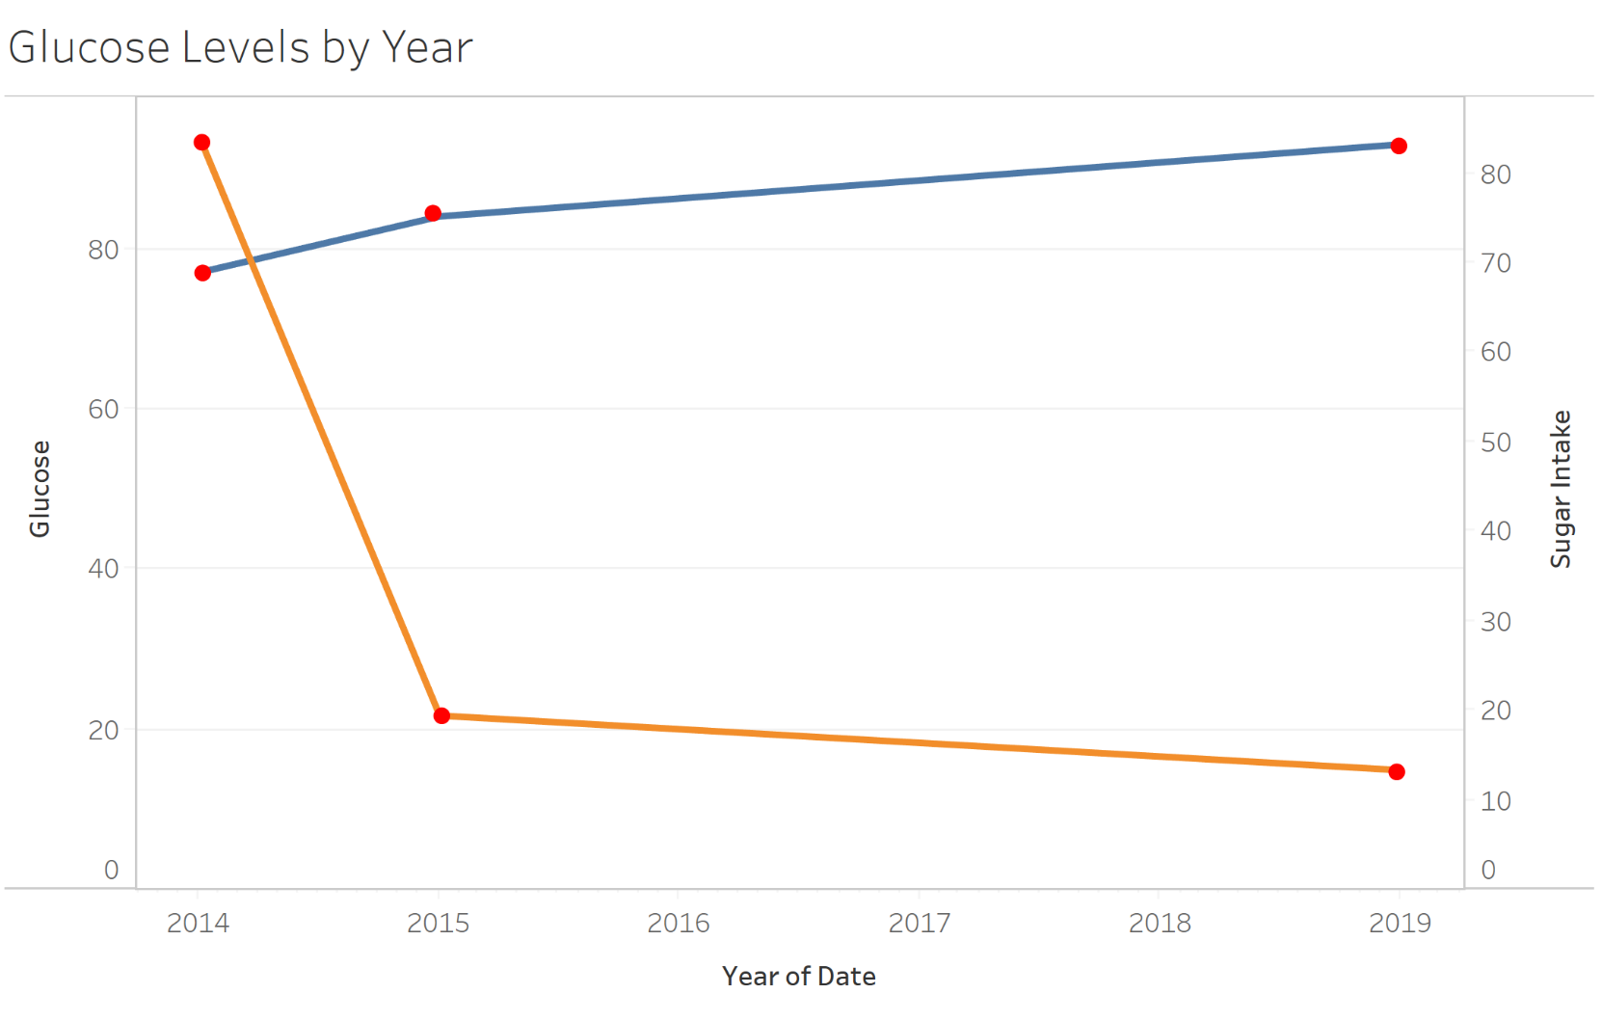
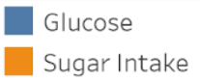
03 Data Visualization-
[Glucose]
(g)
(mg/dL)
Notes:
Here we can see a graph of Jim’s sugar intake in grams, indicated by the orange line, and glucose levels as indicated from his bloodwork on the blue line. We only have data for both of these variables in the years of 2014, 2015, and 2019 which are marked in red on the graph. Clearly, Jim’s sugar intake dropped drastically between the years 2014 and 2015. This was around when Jim switched to a keto diet, which requires very low carbohydrate and sugar intake. Interestingly, his blood glucose levels did not drop significantly during this time, however, his glucose ranged from 77 to 93 during these years which is well within the healthy range of up to 140 milligrams per deciliter. There are other factors that affect blood glucose, such as exercise, stress levels, and quality of sleep. Blood glucose does also tend to increase as you age as well.

Slide 14
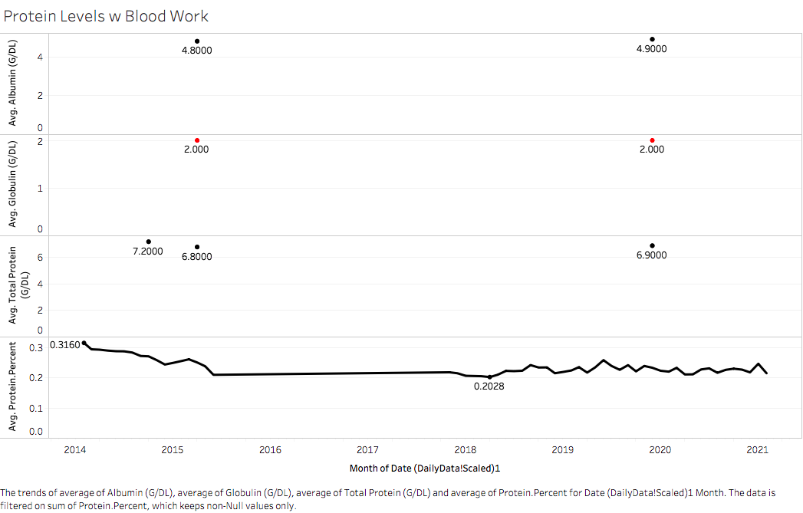
03 Data Visualization- [Protein: Albumin/Globulin]
Protein in Blood
Levels | Status
Albumin: 3.4-5.4 g/dL | Optimal
Globulin: 2.0-3.9 g/dL | Optimal
Ratio: 1.1-2.5 g/dL | Optimal
<Things to watch for>
Protein intake has remained fairly constant
Globulin level is getting low
Albumin/Globulin ratio is borderline

Slide 15
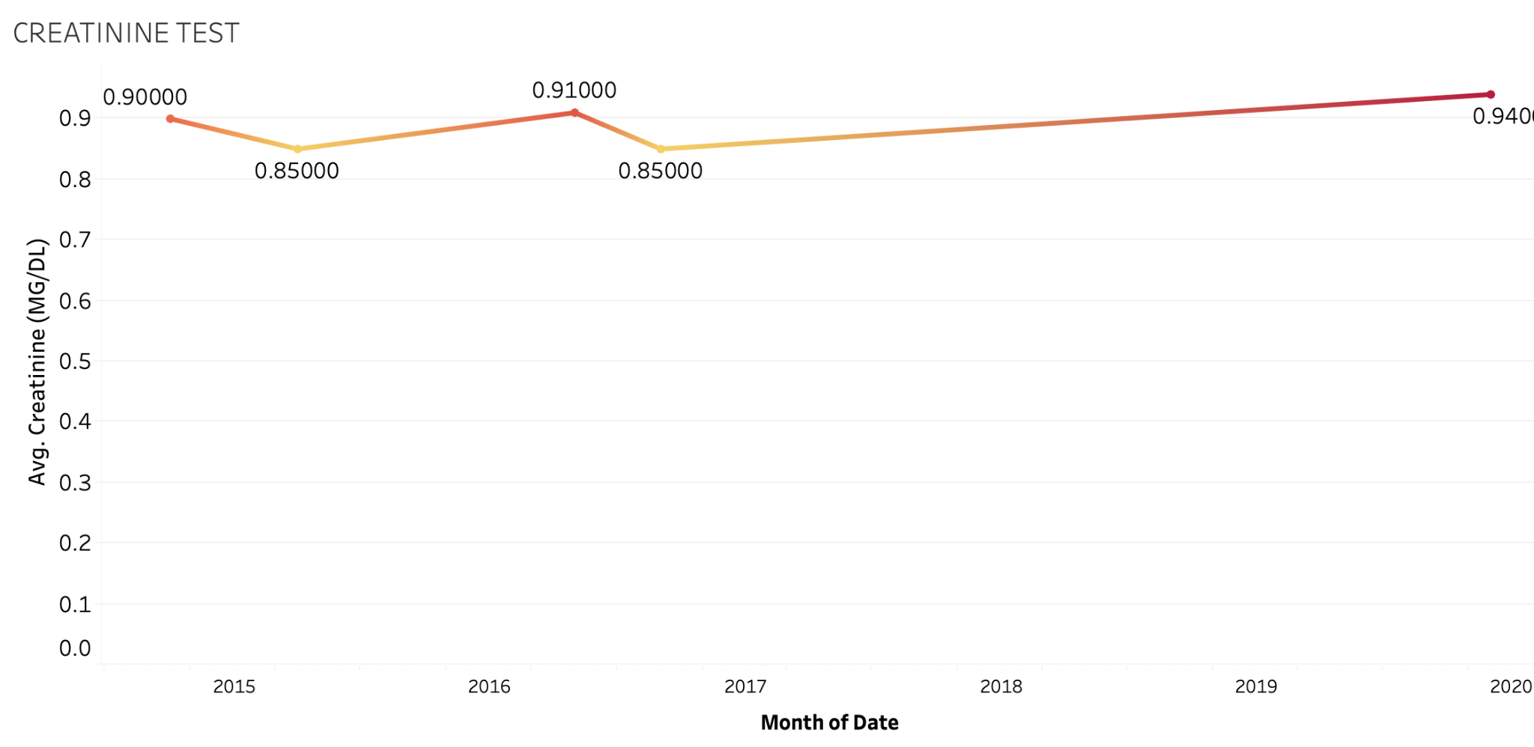
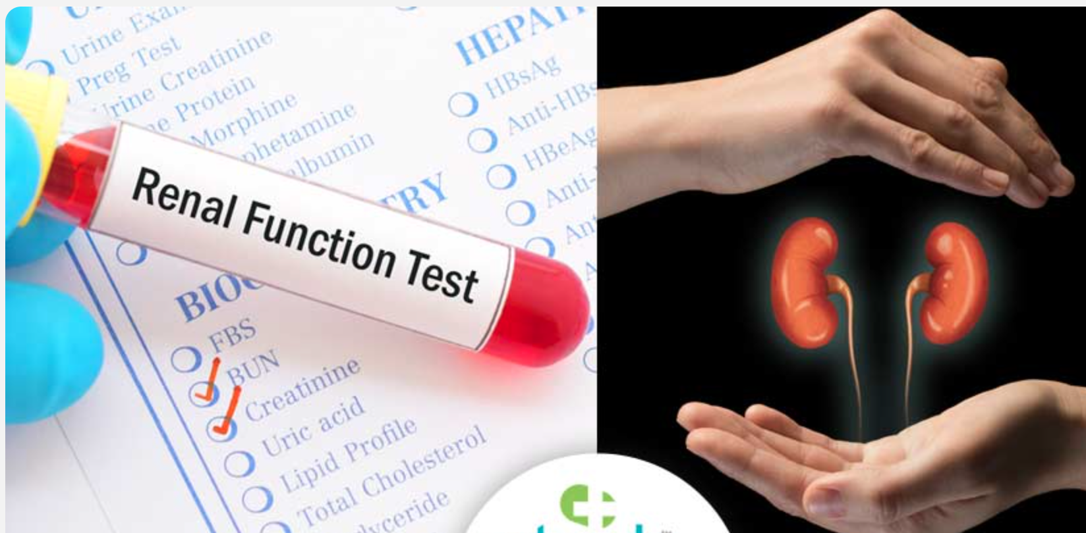
03 Data Visualization- [Creatinine]
Creatinine in Blood
Levels | Status
Creatinine: 0.74 - 1.35 | Optimal
<Things to watch for>
Creatinine level has remained within optimal range around .9
Creatinine level has decreased from .90 to .85 in 2014 and then increased to .95 by 2019.

Slide 16
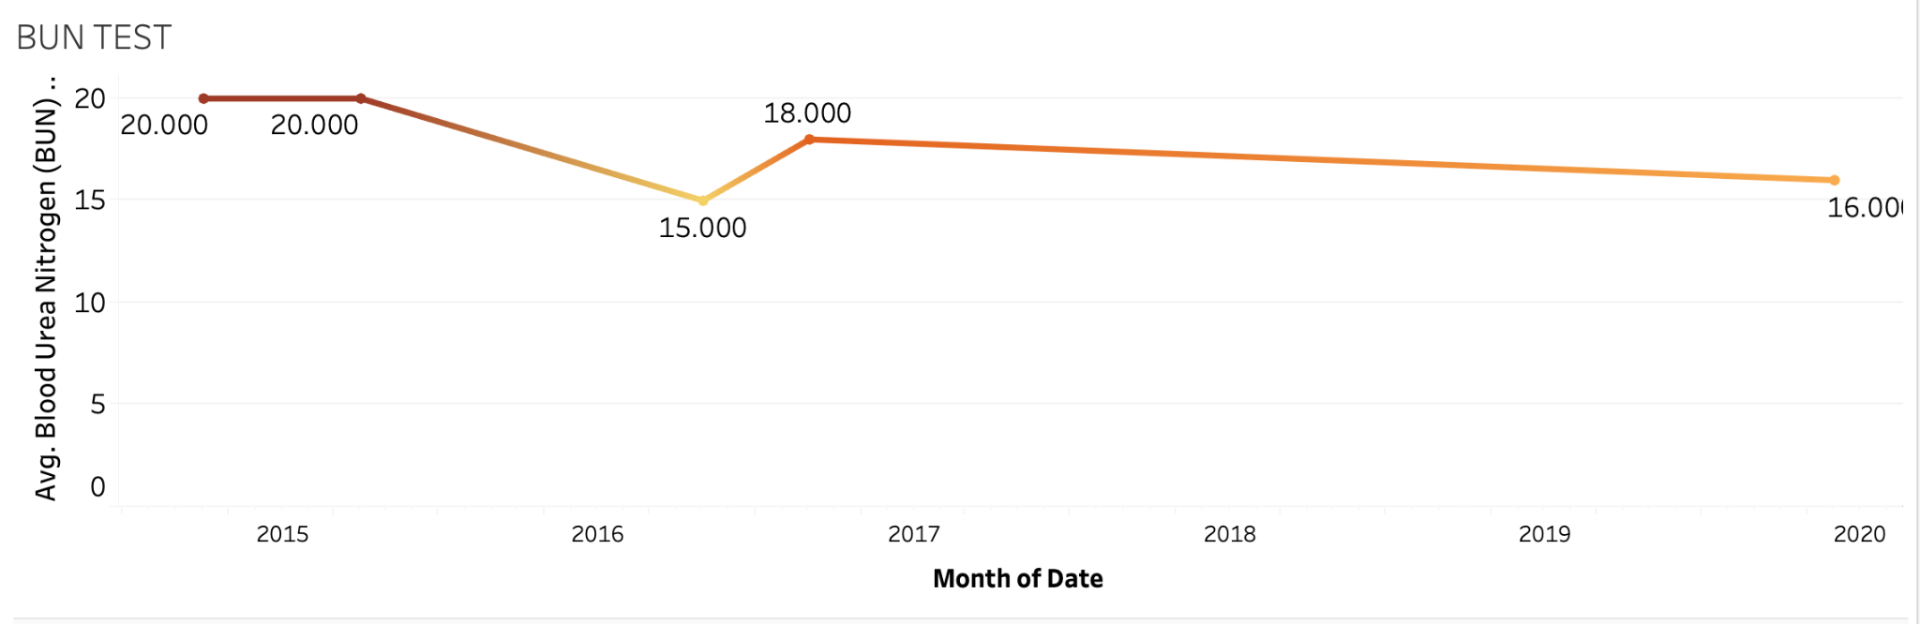
04 Data Visualization
03 Data Visualization- [BLOOD UREA NITROGEN (BUN)]
[ BUN - Chesta ]
BUN in Blood
Levels | Status
BUN: 7- 20 MG | Optimal
<Things to watch for>
BUN level has kept decreasing overtime from 20 in 2015 to 16 by 2020.
BUN level usually increase as you grow older, but we see reverse trend here.

Slide 17

03 Data Visualization- [Variables]
Variables
Cholesterol (MG/DL)
: Cholesterol is a waxy type of fat, or lipid, which
moves throughout your body in your blood.
LDL (MG/DL)
: Low-Density Lipoprotein (LDL) cholesterol is often called the “bad cholesterol” because it collects in the walls of your blood vessels, raising your chances of health problems like a heart attack or stroke.
All
related to
HDL (MG/DL)
: High-density lipoprotein (HDL) is the other main
lipoprotein. HDL is often called the “ good cholesterol.”
Notes:
I was in charge of investigating variables Cholesterol, LDL, HDL. Cholesterol, as we might already know, it’s a waxy type of fat that moves throughout your body in your blood. Lipids are substances that do not dissolve in water, so they do not come apart in blood. Your body makes cholesterol, but you can also get it from foods. Cholesterol is only found in foods that come from animals.
LDL cholesterol is often called the “bad” cholesterol because it collects in the walls of your blood vessels, raising your chances of health problems like a heart attack or stroke.
Last but not least, HDL is often called the “ good cholesterol.” Having high levels of HDL also has antioxidant effects, and research has also linked this to a reduced risk of heart disease.
Overall, these ingredients have a strong correlation with fat.

Slide 18
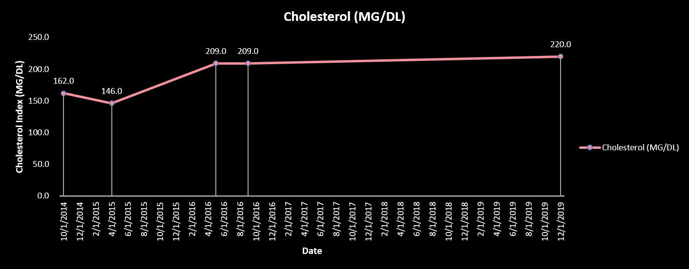
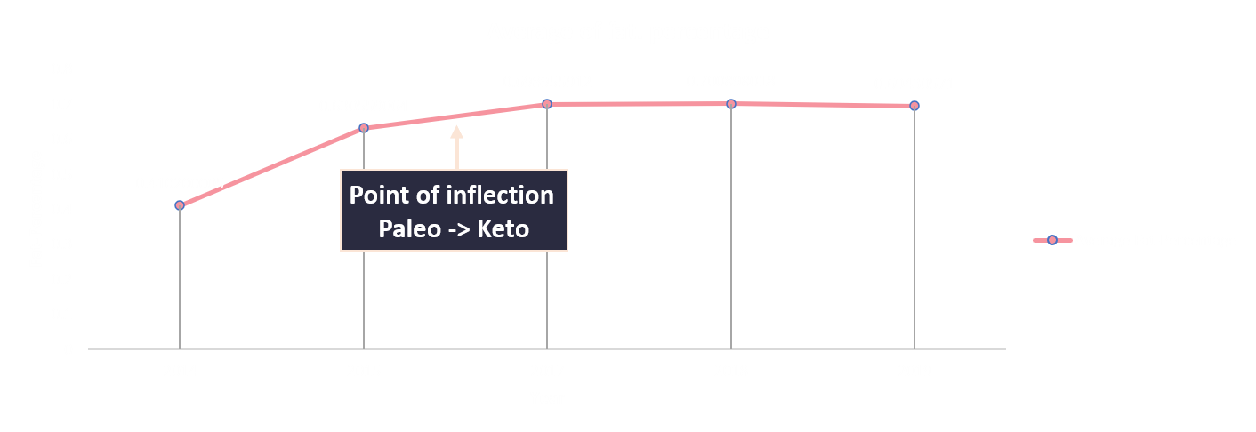
03 Data Visualization- [Cholesterol(MG/DL) – Average of fat. Percent]
Borderline high
Borderline high
Borderline high
Borderline high
cholesterol levels | Status
<= 200 (mg/dL) | desirable
200 - 239 (mg/dL) | borderline high
>= 240 mg/dL | high
<Things to watch for>
Borderline high cholesterol levels
Is this a good cholesterol?
Or a bad cholesterol?
Jim is following his diet properly
Notes:
Now then let’s move on to the analysis part. There was a significant change between 2014 to 2015 which is highly related to Jim’s Diet method change. As Chesta introduced the difference between Paleo and Keto, Keto Diet encourages a high intake of fat, and we can clearly see that Jim is following the Keto Diet principle very well. When it comes to Cholesterol levels, total cholesterol levels less than 200 milligrams per deciliter are considered desirable for adults. However, after Jim changed his diet method to Keto, the cholesterol levels are increased and considered borderline high. Here then I had to see whether good or bad cholesterol levels have decreased or increased.

Slide 19
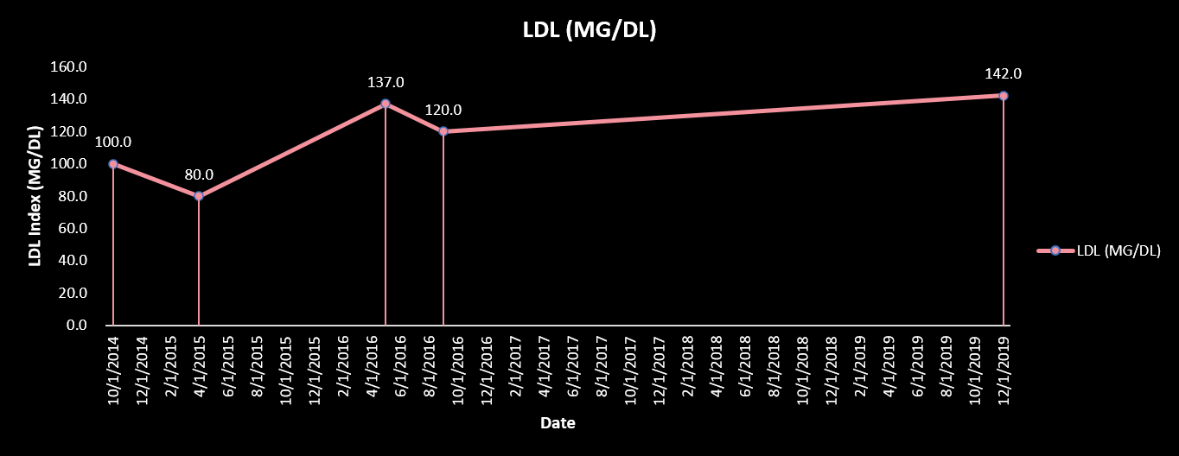
03 Data Visualization- [LDL (MG/DL) – Average of fat. Percent]
“ Bad Cholesterol”
Borderline high
Borderline high
LDL levels | Status
< 100 (mg/dL) | Optimal
100-129 (mg/dL) | Near or above optimal
130-159 (mg/dL) | Borderline high
Keto
Paleo
<Things to watch for>
Borderline high LDL levels
After following the Keto diet, the bad cholesterol level has gotten high
Notes:
When it comes to LDL level as known as bad cholesterol, it reached border high levels after the Keto Diet. The fats linked to LDL cholesterol levels and those that Jim should minimize in his diet are called saturated fats and trans fats. Saturated fats in products that usually come from animals, such as meat, milk, cheese and butter.

Slide 20
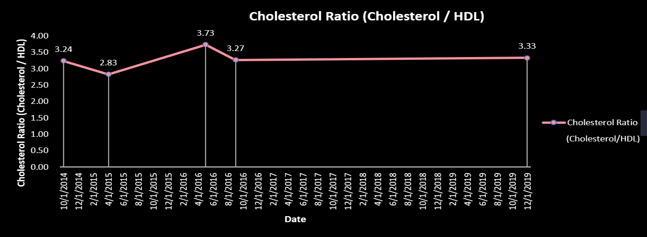
03 Data Visualization- [Cholesterol Ratio (Cholesterol / HDL) – Average of fat%]
“Risk of Heart disease”
Ratio | Status
5.0 | average risk
3.4 | half the average risk
9.6 | twice the average risk
<Things to watch for>
Overall, Jim has a low risk of heart disease
After following the Keto diet, the cholesterol ratio has gotten high
Notes:
Then I compared Cholesterol ratio with HDL level as known as good cholesterol.
In general, the higher the ratio, the higher the risk. Most healthcare providers want the ratio to be below 5:1. A ratio below 3.5:1 is considered very good.
Jim’s Cholesterol Ratio’s overall are in a good shape, he has half risk of heart disease. However, we can see that after following the keto diet the cholesterol ratio has gotten high.

Slide 21
04 Conclusion – Health Care Recommendation for Jim
It is recommended to drink at least 64 OZ of water and intake seasoned food
1
Keep maintaining Protein intake constant
2
Conclusion
Reduce fat intake to help with cholesterol level and LDL level
4
Globulin level is getting low: investigate whether globulin = 2
is too low. -> May be related to poor liver function.
3
Notes:
Through this Nutrition Project, we suggest 4 Health-Care Recommendations for Jim.
first and foremost, when your body enters a state of Ketosis, it runs out of glycogen, a carbohydrate stored in your body, draining a large amount of moisture. At this time, a large amount of salt escapes as well, because insulin secretion decreases, and the kidneys do not reabsorb the salt and just let leaving it out. Therefore, it recommended to drink at least 64 oz of water and intake seasoned food.
The second recommendation is to keep maintaining the protein intake level. Jim has been doing great to keep his diet properly without putting a negative impact on his body. So it’s good to remind him to keep up with his current diet!
Third, I’d recommend keeping an eye on LDL again as known as bad cholesterol level since the LDL level indicates borderline high on recent his bloodwork result. You know, an ounce of prevention is worth a pound of cure.
Last of all, the globulin level is getting low which is slightly below 2.0 g/dl. Based on our research it might be related to poor liver function, so he might need to investigate that.
Globulin level is getting low: investigate whether globulin = 2
is too low. -> Maybe related to poor liver function.

Slide 22


04 Conclusion – Key Takeaways through the project
Key takeaways
1
The importance of collecting an accurate dataset
2
Ability to interpret the data
3
Data Visualization – delivery of information
Notes:
This project was very meaningful to all of us because it was a Real-World data analysis project. We often realize that the dataset in the actual working place is not always in perfect shape. Likewise, we also faced some missing data and through the pre-processing, the actually cleaned dataset was very limited. Through this process, we realized again the importance of collecting an accurate dataset or the importance of having the ability to extract meaningful information in a given situation.
Last but not least, we also learned interpreting the result in a way that could be understood by laypeople is very important.
how we narrative the data to the non-data bacPresenting this data visually and adding pertinent information to complement the business analysis process not only makes it faster and easier to point out areas of opportunities and concern but also enables decision-makers to take action with their
Created 4 multiple regression forecasting models with Tableau and interpreted the result in a way that could be understood by laypeople.
data.

Slide 23
Thank you!
Dr.Xiaohui Chang (Advisor)
Chesta Gupta,
Claire G Elsbree
Eunjeong Heo
Mingyang Zhang
Nayoung Kwon
Robert M Hill
Q&A?

